Slide 1
Chapter 1: Introduction to
Software Engineering Design
Session I: Motivation and General Design Concepts

Slide 2
Session’s Agenda
What’s it all about?
  Motivation for software engineering design
Engineering Design
  Let’s revisit the software engineering life-cycle
  Context of software design
Problem-solving
  Problem-solving process
  Types of problems
  Types of thinking
  Types of solution approaches

Slide 3
Motivation for Software Engineering Design
Let’s go straight to the point, what is software engineering?
  According to the IEEE [1], Software Engineering is:
    (1) the application of a systematic, disciplined, and quantifiable approach to the development, operation, and maintenance of software; that is, the application of engineering to software.
    (2) The study of approaches as in (1)
What do we mean by systematic? According to an online dictionary [2]:
  Presented or formulated as a coherent body of ideas or principles
  Methodical in procedure or plan
What do we mean by disciplined? (From the word discipline [2]):
  A rule or system of rules governing conduct or activity
What do we mean by quantifiable? (From [2])
  To determine, express, or measure the quantity of
Given clear definition of these important terms, let’s ask ourselves, do we really need a systematic, disciplined, and quantifiable approach to developing software? Let’s look at some examples…

Slide 4
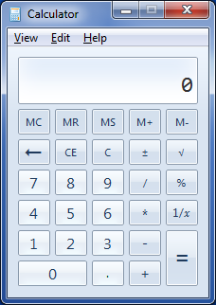
Motivation for Software Engineering Design
A software example: The Mighty Calculator
  (1) Do we need software engineering to develop this product?
    Do we need a systematic approach?
    Do we need a disciplined approach?
    Do we need a quantifiable approach?
Stop and think about these questions! You may be wondering, well…, it depends!
  (2) Is this my own pet project?
  (3) Is somebody paying me for this product?
  (4) Will other people use this product?
  (5) Is there a time-frame for this product’s development?
  (6) Do I need to quantify the approach used?
Depending on (2), (3), (4), (5), and (6) the answer to (1) may be: yes, no, or maybe!!
Let’s look at another example…

Slide 5
Motivation for software Engineering Design
Question | Chevy Volt video | X-47B unmanned aircraft http://www.youtube.com/v/kBrVRTVNph0
Is Software Engineering Design needed in these software? Why? (give 3 short justifications)
Where does software engineering design applied in these software development?

Slide 6
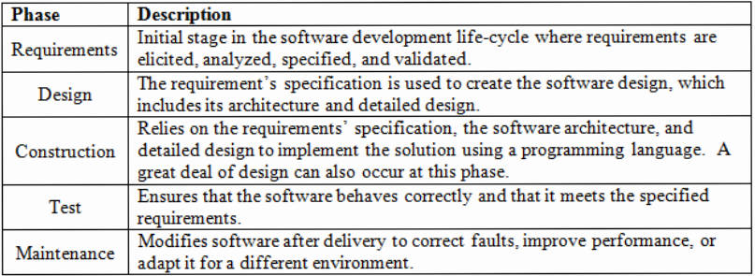
Engineering Software
Hopefully, by now, your are convinced that a systematic, disciplined, and quantifiable approach is needed to build certain types of software systems; that is, software engineering is necessary to build some (if not all) software products. But how do we engineer software?
Luckily, a formal process for engineering software has been known for quite some time. This process supports a systematic, disciplined, and quantifiable approach to software product development, and includes the following phases:
Of importance to this course is the design phase, where requirements are used to create a blueprint of the software to be constructed. Before delving deep into software engineering design, let’s look at the general concept of engineering design…

Slide 7
Engineering Design
Design is not a new concept conceived by software engineers. Design is used in all other engineering disciplines, e.g., electrical, mechanical, civil, etc. Dym and Little define engineering design as [6]:
  A systematic, intelligent process in which designers generate, evaluate and specify designs for devices, systems or processes whose form(s) and function(s) achieve clients’ objectives and users’ needs while satisfying a specified set of constraints.
Design is a lengthy and complex process which requires significant investment in time and effort. So, why conduct design in engineering disciplines?
  Using commonsense, complex products (e.g., bridges, airplanes, watercrafts, medical devices, safety-critical software systems, etc.) are hard to create, costly to change, and when built carelessly, can harm human life.
  Design allows teams to organize in disciplined manner and provides a systematic approach to carefully ensure that products are built to meet their specification.
    Remember the definition of software engineering??
Disciplined, systematic…
these look familiar,
right??

Slide 8
Engineering Problem Solving
In the previous slide, engineering design was defined as an intelligent process… what do we mean by intelligent process?
  We refer to it as intelligent process because a great deal of problem-solving occurs during design.
  During the design process, engineers are constantly engaging in problem-solving activities.
    Their work requires them to identify, evaluate, and proposed solutions to complex problems.
    Some problems encountered by engineers have never been solved before!
Because of the large number of problem-solving activities present during design, a formal discussion on problem-solving is required.
  To become a good designer, engineers must be good problem solvers.
  To become a good problem solver… well, that requires lots of time and effort, but we can at least set up a framework for solving problems throughout the design phase. Let’s examine the fundamentals of problem solving…

Slide 9
Engineering Problem Solving
In a general sense, problem-solving during design occurs in three different states:
  Initial State
  Operational State
  Goal State
Initial State
  Problems are formulated and interpreted
  In some cases, understanding the problem is a problem itself.
Operational State
  Once problem is understood, operational state begins
  Thinking about the problem and viable solutions come to light
Goal State
  Once an appropriate solution is identified, evaluated, and validated, goal state is reached
  Final solution found, marking the end of the problem-solving process
Initial
Sate
Problem Interpreted
and Formulated
Goal
Sate
Operational
Sate
Solution Identified,
evaluated, and validated

Slide 10
Engineering Problem Solving – Initial State
Moving from state-to-state (i.e., initial→operational→goal) is not as simple as it sounds. During the Initial State of problem solving, it becomes evident that not all problems are the same; they vary in size, complexity, and the amount of time required to reach the goal state. Problems can be classified as:
  Well-defined
  Ill-defined
  Wicked Problem
Well-defined problems have clear defined goals and their constraints are well understood.
  This makes scoping the problem, proposing a solution, and arriving at a the solution easier than with other types of problems.
Ill-defined problems are ambiguous with undefined goals.
  They require more time and effort to clarify and interpret the problem
  Sometimes, these problems can be transformed into well-defined problems.
  Once formulated, we can move on to propose and arrive at a solution.

Slide 11
Engineering Problem Solving – Initial State
Wicked-problems are problems where no single formulation exists.
  Many acceptable formulations can take place with no definite solution
  Solutions are not deemed correct or incorrect, but good or bad
  They require more time and effort to propose and arrive at “some” solution
  The problem is formulated after it has been solved!
Example of wicked problems include:
  Healthcare
  Global climate change
  Border security
  Design, more to the point, software design
    Design a secure system
    Design a usable system
    Design a maintainable system
Design is a wicked problem, and during the design process, many well-defined, ill-defined, and wicked sub-problems are encountered!
Well-
defined
Well-
defined
Wicked
Well-
defined
Wicked
Well-
defined
Well-
defined
Ill-
defined
Ill-
defined
Ill-
defined
Wicked
Well-
defined
Ill-
defined
Well-
defined
Wicked
Design
“Wicked Problem”

Slide 12
Engineering Problem Solving – Initial State
Let’s use a bird’s eye view and tackle Design as a problem. During the Initial State, we classify it as a Wicked Problem. Why does this make sense?
  Consider the following task: Develop a secure software system.
    What is the goal?
      That’s easy, to design and develop a secure system!
    What is the problem? More specifically, can we formulate this problem in a way that can be solved?
      Stop and think about this!
  Consider the following task: Develop a usable system.
    What is the goal?
      Easy again, to design and develop an “easy to use” system.
    Can we formulate this problem in a way that can be solved?
      We can certainly try, but you will find that most of the time, the problem can only be formulated after many iterations between customer and designer and only after an acceptable solution has been found!
Designers spend a great deal of time formulating acceptable versions of these wicked problems! That is, acceptable to stakeholders, including customers, managers, etc.
  For example, an attempt to problem formulation for developing a secure software system may include creating an authentication (e.g., username and password) mechanism. Although this may be an acceptable problem formulation for the project’s stakeholders, it clearly does not solve the security problem!

Slide 13

Engineering Problem Solving – Operational State
During the Operational State of problem solving, it becomes evident that not all problems can be tackled the same way. Different techniques for problem-solving can be employed, including:
  Divide and conquer
  Reusing solutions, e.g., patterns.
Many times, problem-solving requires a “think outside the box” mentality. What exactly does this mean?
  In a nutshell, it means that we need to think in ways that deviate from conventional wisdom.
For example, try solving the popular nine-dot puzzle problem using the figure to the right and the following requirements:
  Draw four straight lines to connect all dots.
  The pencil cannot be lifted from the paper once the line-drawing process begins.
  No lines can be retraced.
  A line must pass through every dot.

Slide 14
Engineering Problem Solving – Operational State
During the Operational State of problem solving, it is natural to perceive and approach problems in certain ways, based on our current knowledge.
  For example, the nine-dot problem resembles a square, therefore it is hard for some people to operate outside of the assumption that lines should begin and end on a dot.
  This functional fixedness limits the ability to find solutions based on objects having a different function from their usual ones.
To increase the chance of overcoming functional fixedness, problems need to be attempted several times and considered from many different viewpoints and unusual angles.
  Don’t forget about this… this advice will come in handy during the software architecture activity!

Slide 15
Engineering Problem Solving – Operational State
During the Operational State of problem solving, different types of thinking takes place.
  Convergent thinking
  Divergent thinking
Convergent thinking
  Type of thinking that seeks to find one single solution to a problem, e.g., a math problem.
Divergent thinking
  Type of thinking that seeks to find multiple solutions to a problem.
  This type of thinking is associated with originality, inventiveness, and flexibility.

Slide 16
Engineering Problem Solving – Operational State
During the Operational State of problem solving, different problem-solving methods take place.
  Algorithms
  Heuristics
Algorithm
  Step-by-step procedure for finding the correct solution to a given problem.
  Do not normally involve subjective decisions or rely on intuition or creativity to find solutions.
  Examples:
    Bubble sort, Merge sort, etc.
Heuristic
  Rules of thumb (or procedure) that may or may not lead to the solution of a problem.
  In some cases, they can lead to optimal solutions, in others, they can lead to solutions that are far from optimal, or no solution at all!
  Heuristics are advantageous when tackling tough problems where an efficient algorithm may not exist.

Slide 17
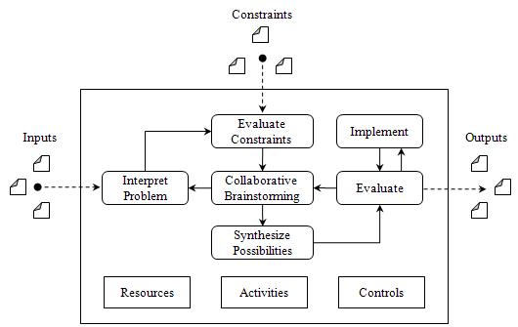
Engineering Problem Solving – Holistic Approach
We can use everything discussed so far to come up with a holistic problem-solving framework that can help us tackle problems of any size during the design process. The framework consists of the following tasks:
  Interpreting the problem
  Evaluating the constraints
  Collaborative brainstorming
  Synthesizing the possibilities
  Evaluating the solution
  Implementing the solution
In addition, we must consider:
  Resources
    Means by which activities are performed, e.g., people, software, hardware.
  Activities
    Internal tasks determined by the development organization that must be followed when solving problems, e.g., architecture, detailed design, status reports, etc..
  Controls
    Internal constraints set by the development organization so that problem solutions aligns well with organizational goals and processes, e.g., processes, permitted tools, etc.

Slide 18
Engineering Problem Solving – Holistic Approach
  Interpreting the problem
  Performed during the Initial State of problem-solving
  Problem classification, e.g., well-defined, ill-defined, wicked.
Evaluate constraints
  Identify external constraints to set bounds on the solution landscape.
Collaborative brainstorming
  Performed during the Operational State of problem-solving.
  Think about different solutions to the problem, i.e., divergent thinking.
Synthesize the possibilities
  Performed during the Operational State of problem-solving.
  Switch to convergent thinking to seek one acceptable solution.
Evaluate solution
  Performed during the Operational State of problem-solving.
  Flaws in the solution may trigger a transition back to the collaborative brainstorming activity.

Slide 19
Summary of Engineering Design and Problem-Solving
We’ve provided general information about engineering design.
  Motivation for software engineering design
  General engineering concepts
  General problem-solving concepts
In the next session, we will focus our efforts to explain engineering design in the software domain, i.e., software engineering design. Specifically, we will cover:
  A focused discussion on software engineering design
  Software design challenges
  Software design process
    Software architecture
    Detailed design
    Construction design
    HCI design

Slide 20
References
[1] IEEE. “IEEE Standard Glossary of Software Engineering Terminology.” IEEE, 1990. http://ieeexplore.ieee.org/xpl/mostRecentIssue.jsp?punumber=2238, Retrieved on August 23, 2012.
[2] http://www.merriam-webster.com/dictionary/systematic
[3] http://news.cnet.com/8301-11128_3-20021346-54.html, Retrieved on August 23, 2012.
[4] http://www.youtube.com/watch?v=CjjASGV36mw&feature=player_embedded, Retrieved on August 23, 2012.
[5] http://www.as.northropgrumman.com/products/nucasx47b/assets/X-47B_Navy_UCAS_FactSheet.pdf, Retrieved on August 23, 2012.
[6] Dym, Clive L., AND Patrick Little. Engineering Design: A Project-Based Introduction. Hoboken, NJ: Wiley, 2008.

